Slide 1
Data-Path
Computer Organization & Design
Chapter 4.3
Data path
Milad Malekzad
Dr. House
Nov 12 2015

Slide 2
General Information
Designed to educate 10th graders
Will teach them how data path R-type works in a computer
Data path ( Section 4.3)
Will be finished by 30 Nov 15
Will inform the students why Data path is important and how data path works in computers.

Slide 3
Explanation
The project will detail the material given in chapter 4 section 3 of the book, which focuses on building data path.
How many operands R-format instruction have, how many data words do we need from register file and register file for each instructions
How input register file specifies the register number to be read and the output from register file will carry the value.
How to write a data word for the inputs
How the operation occurs in ALU and carry it to registers

Slide 4
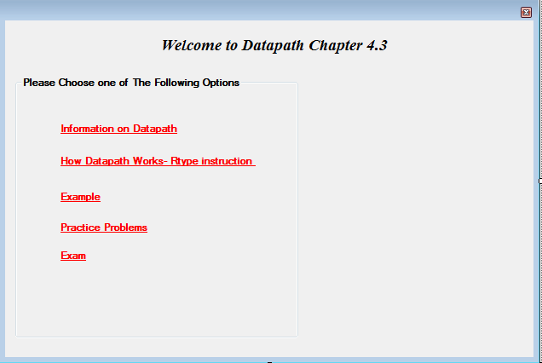
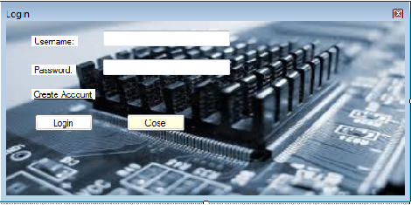
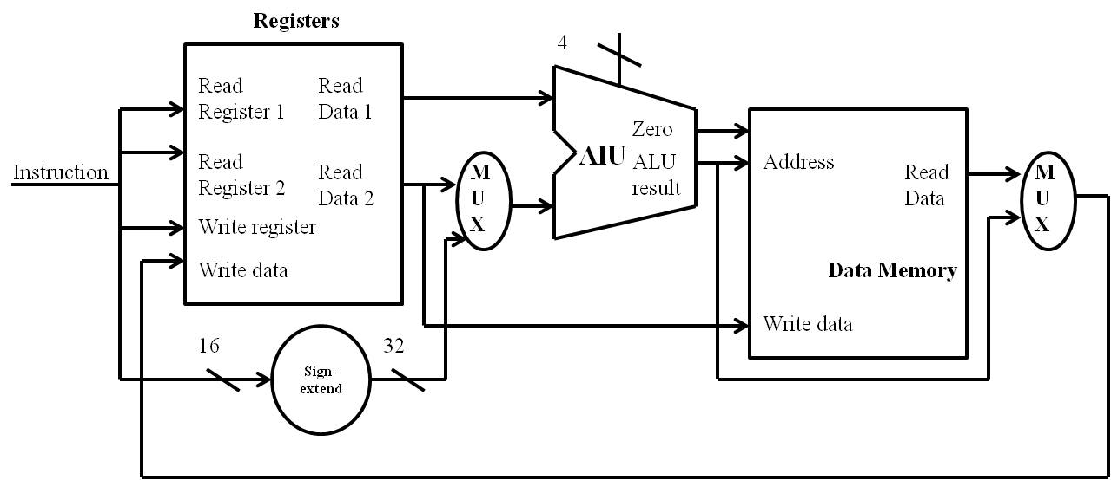

Slide 5
Schedule
10th October, Submitting the purposle
23rd October: Make the forms
10th of November : coding
21st debugging
29th done with the project

